Slide 1
VP-Dibris Smart Parking
Final project of IOT course 2021
Magno Alessandro
4478234

Slide 2
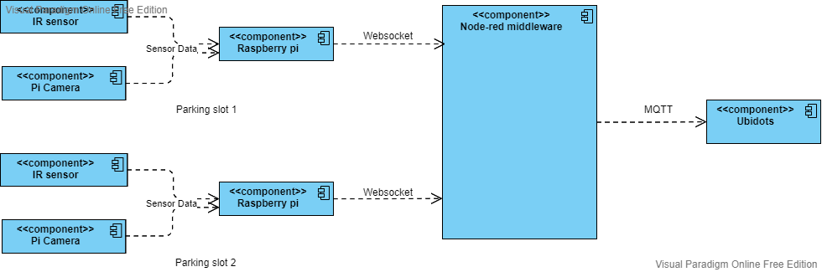
Architecture

Slide 3
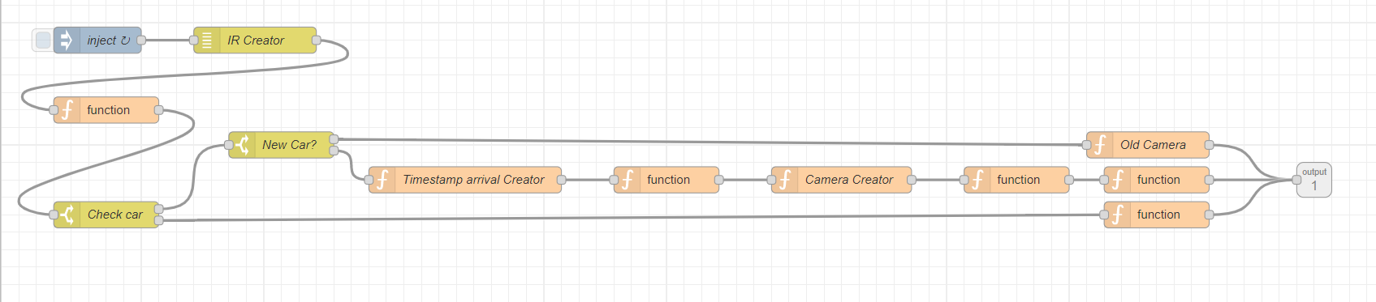
Sensor data simulation

Slide 4
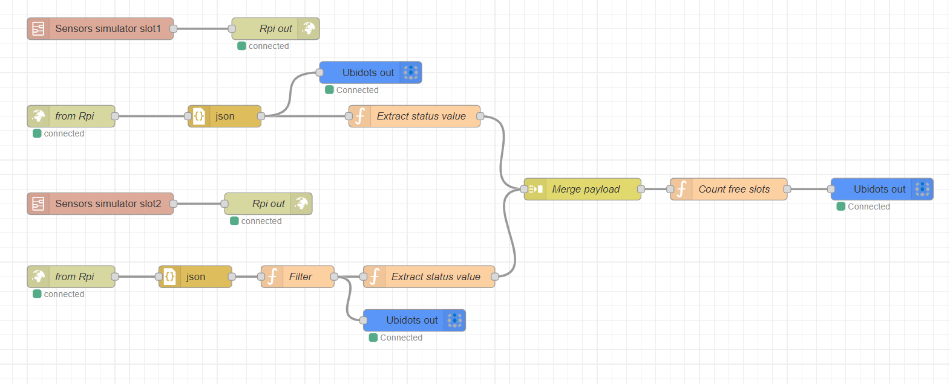
Middleware

Slide 5
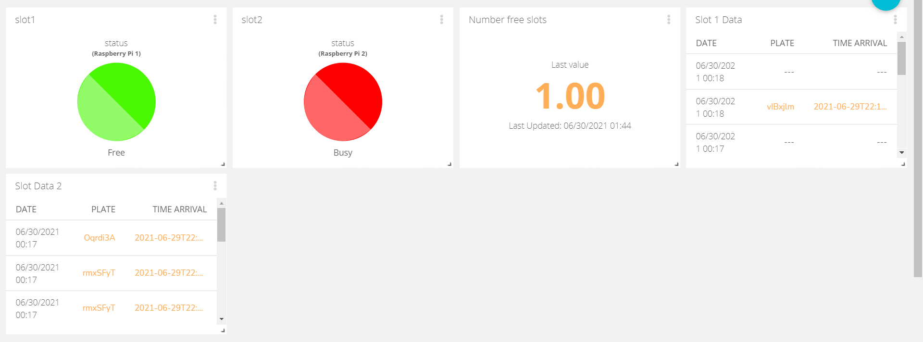
Dashboard Ubidots

